Slide 1
Electronic Data Interchange (EDI)
Presented By
Shubham Kumar Choudhary

Slide 2
content
1.Electronic Data Interchange
2.Features of EDI
3.Components of EDI
3.1 Diagram of components of EDI
4. Application Services
4.1 Diagram Application Services
5. Translation service
5.1 Diagram Translation service
6. Communication service
6.1 Diagram Communication service
7. Advantage of EDI
8. Disadvantages of EDI
9. Benefits of EDI
10. EDI Benefits

Slide 3
Electronic Data Interchange
Electronic Data Interchange (EDI) is the computer-to-computer exchange of business documents in a standard electronic format between business partners.

Slide 4
Features of EDI
Exchange of structured business information in standard formats between computers.
It has reduced data entry link, eliminates the need for a paper bases system and improved business cycle.
EDI transfer structured business documents internally among groups of departments or externally with its suppliers, customers and subsidiaries.
The two companies or groups which exchanged information through EDI are called the Trading partners.

Slide 5
Components of EDI
There are 3 types of component
Application service
Translation service
Communication service

Slide 6
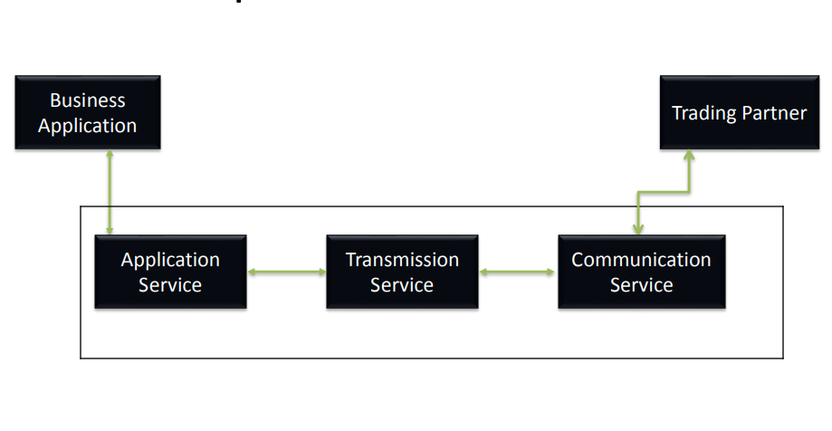
Components of EDI

Slide 7
1.Application Services
It provides the link between application and EDI.
It allows you to send documents from an EDI system.
The set of callable routine is used to transfer document from the business application into EDI document destination can be either intra-company or to the external companies.

Slide 8
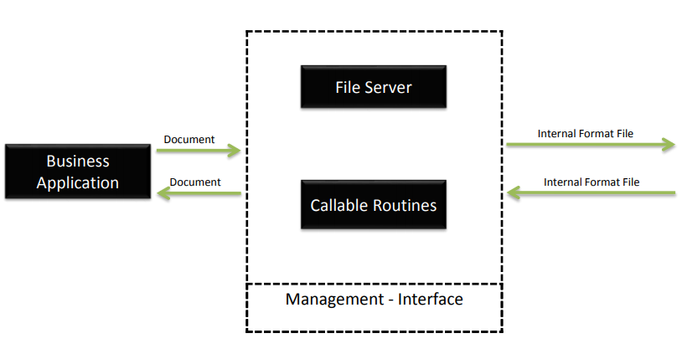
Application Service

Slide 9
2.Translation service
Converts the out going documents from an internal format file to an agreed external format.
Translates internal document from external format to EDI internal format file.

Slide 10
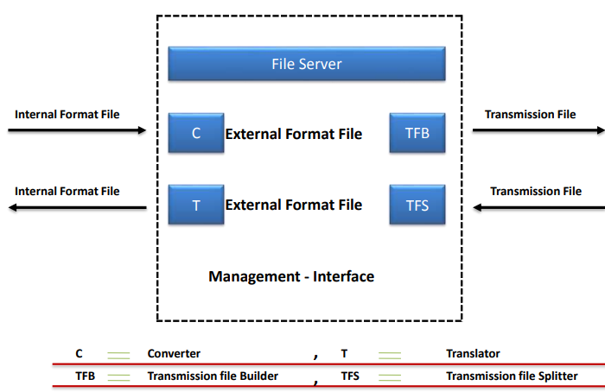
Translation Service

Slide 11
3. Communication service
The communication service sends and receives transmission files to and from the trading partners either directly or by using party service called a valued added network(van).

Slide 12
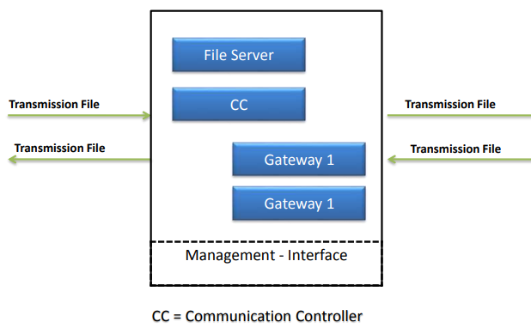
Communication Service

Slide 13
Advantage of EDI
Generation of a paper document on a form by software application.
Delivery of a few copies of document to the internal dept to be filed and others to the trade partners via postal service.
Generation of a paper acknowledgement and sending it to the originating company.
Generation of a file containing the processed document by the application program.

Slide 14
Disadvantages of EDI
Contrasted to XML, which is not strictly standardized, many consider EDI to have too many standards.
EDI systems are extremely expensive making it difficult for small businesses to implement.
Many large organizations will only work with others who utilize EDI. This may limit the business small companies are able to do with such organizations and limit trading partners.

Slide 15
Benefits of EDI
Transactions speed
Direct transmission
Cut down the possibility of human error
Reduces the risk of lost data

Slide 16
EDI Benefits
Cost Reduction
Manpower, communications, resources, storage.
Speed
Electronic transfer Vs mail/ courier
Accuracy
Information less susceptible to interception/ falsification
System integration
EDI can be integrated with internal system to push & pull data

Slide 17
Thank you

